Slide 1
19Z604 Embedded Systems
Dr.N.Arulanand,
Professor,
Dept of CSE,
PSG College of Technology

Slide 2
Real Time Operating Systems
REAL TIME OPERATING SYSTEMS: Real-Time Concepts - Task Management - Task Scheduling - Classification of Scheduling Algorithms - Clock Driven Scheduling - Event Driven Scheduling - Resource Sharing - Priority Inheritance Protocol - Priority Ceiling Protocol - Inter Task Communication - Mutex - Semaphores - Message Queues - Timers - Commercial RTOS – VxWorks - RTLinux

Slide 3
Types of Schedulers
1. Clock-driven Schedulers : based on clock interrupt.
1.1 Table driven
1.2 Cyclic Scheduler
2. Event-driven Schedulers
2.1 EDF (Earliest Deadline First)
2.2 RMA (Rate Monotonic Analysis)
2.3 DMA (Deadline Monotonic Analysis)
3. Hybrid
Round-robin

Slide 4
Earliest Deadline First (EDF)
Dynamic priority scheduling
Whenever a new task arrive, sort the ready queue so that the task closest to the end of its period assigned the highest priority
Preempt the running task if it is not placed in the first of the queue in the last sorting

Slide 5
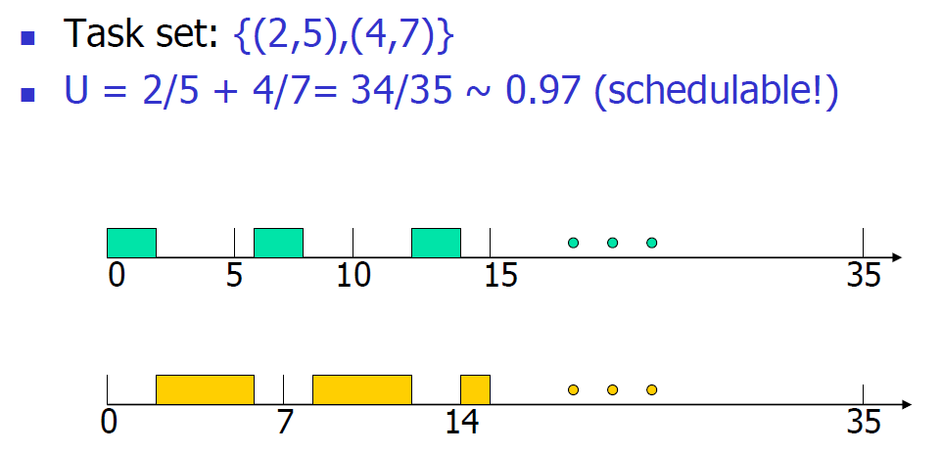
Earliest Deadline First (EDF)

Slide 6
Schedulability Criteria for EDF

Slide 7


Schedulability test for RMA
Necessary Condition
A set of periodic real-time tasks would not be RMA schedulable unless they satisfy the following necessary condition:
Sufficient Condition: Liu and Layland’s condition

Slide 8
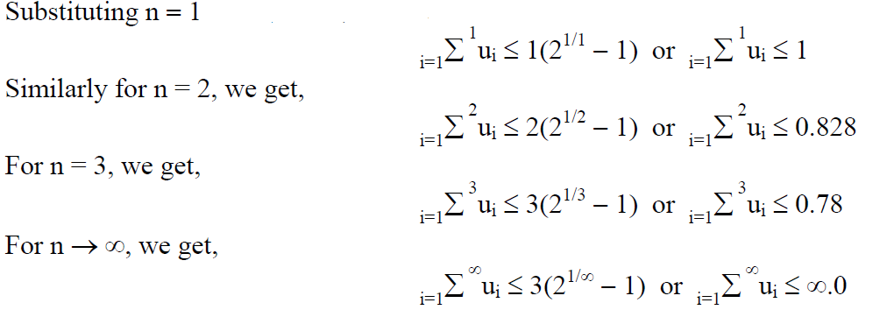
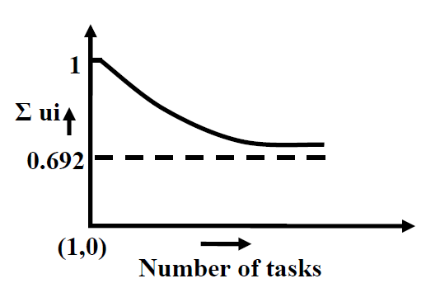
Utilization Bound Test (U_{B})

Slide 9
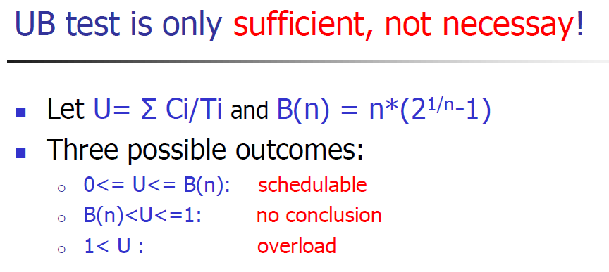
RMA

Slide 10
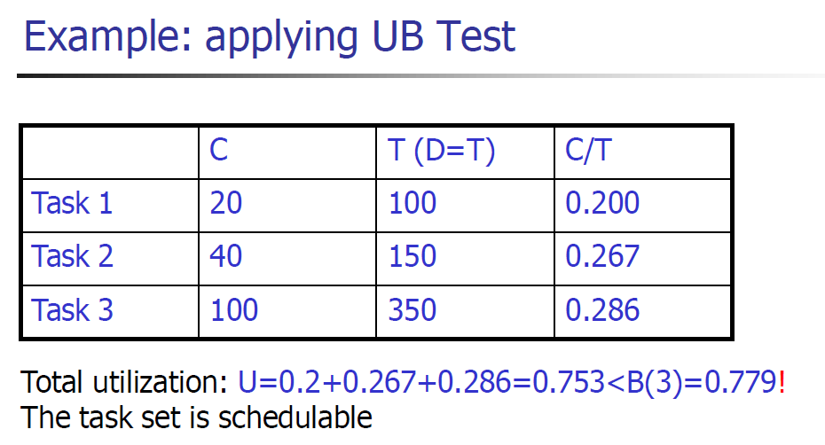
Exercise

Slide 11
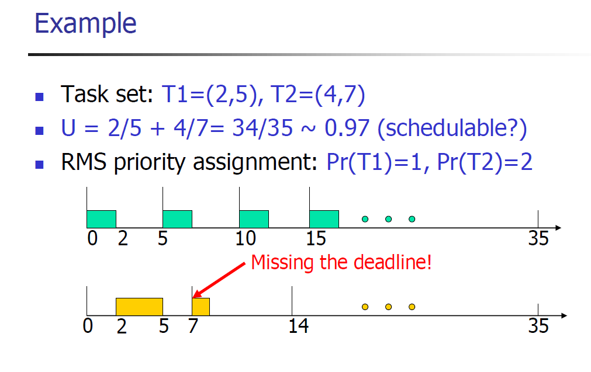
RMA
P (T1) > P (T2)
For Task T1:
E1 <= P1
2 < 5 T1 meets deadline
E2 + ceil(P2/P1)*e1 <= p2
4 + ceil(7/5)*2 <= 7
4 + 2*2 <= 7
8<=7 T2 doesn’t deadline

Slide 12
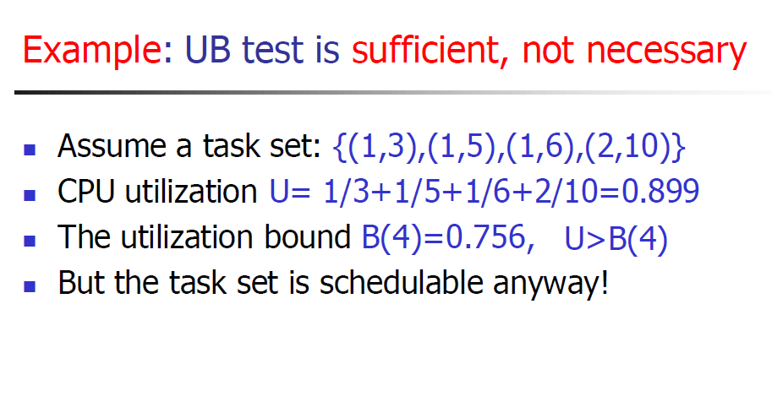

Slide 13
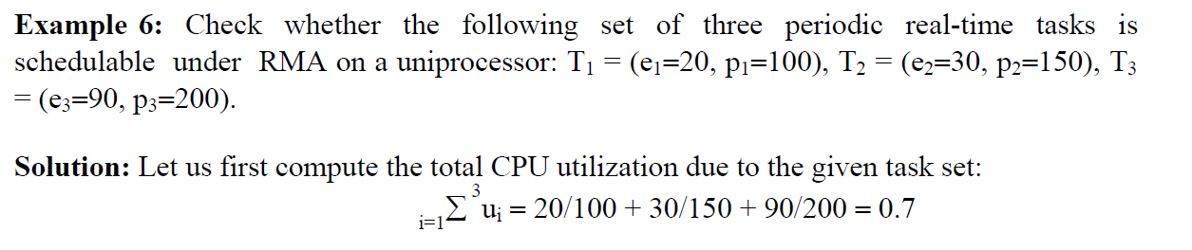
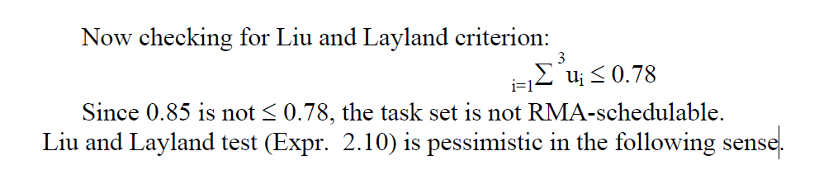
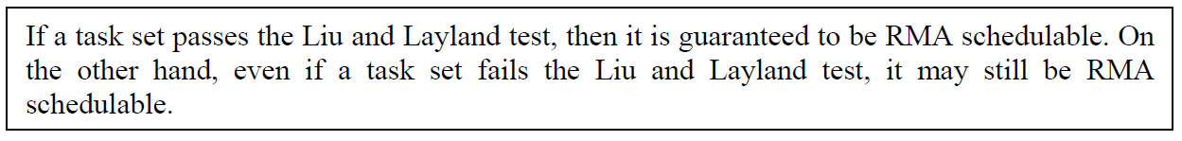
Lehoczky’s Test

Slide 14
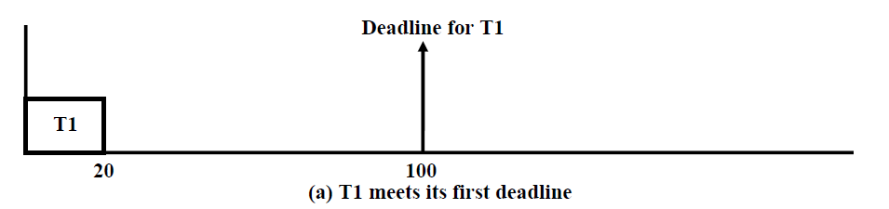
Lehoczky’s Criterion for Tasks

Slide 15
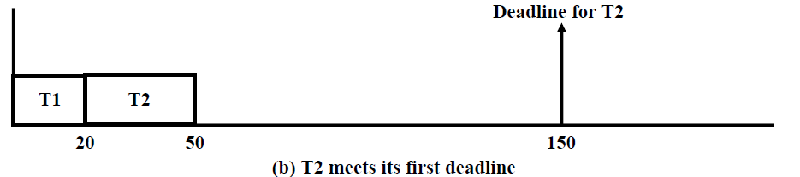

Lehoczky’s Criterion for Tasks

Slide 16
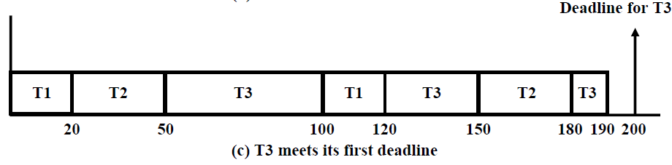
Lehoczky’s Criterion for Tasks

Slide 17
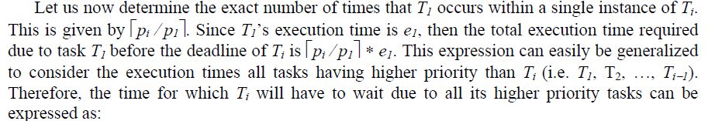

Lehoczky’s Test

Slide 18
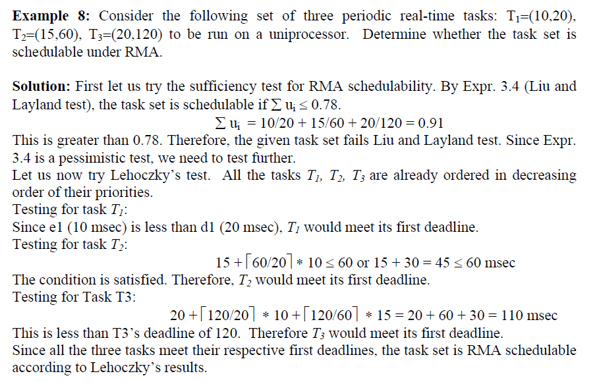

Slide 19

Deadline Monotonic Algorithm (DMA)
RMA no longer remains an optimal scheduling algorithm for the periodic real-time tasks, when task deadlines and periods differ
DMA is essentially a variant of RMA and assigns priorities to tasks based on their deadlines, rather than assigning priorities

Slide 20

Lehoczky’s Test

Slide 21
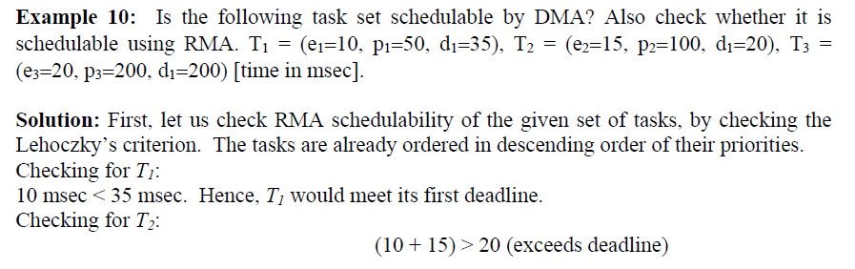
For Task T2: I = 2
E2 + ceil(d2/p1)* e1 <= d2
15 + ceil(20/50)*10 <= 20
15 + 1*10 < = 20
25 <=20 T2 doesn’t meet deadline

Slide 22
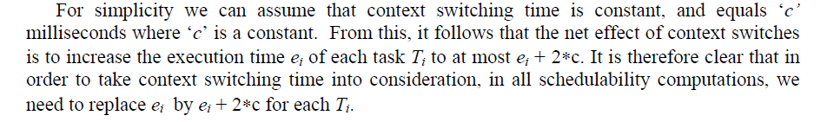
Context Switching Overhead

Slide 23
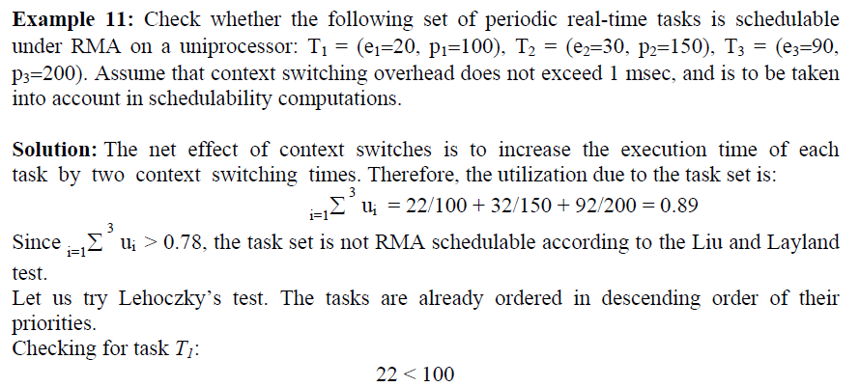
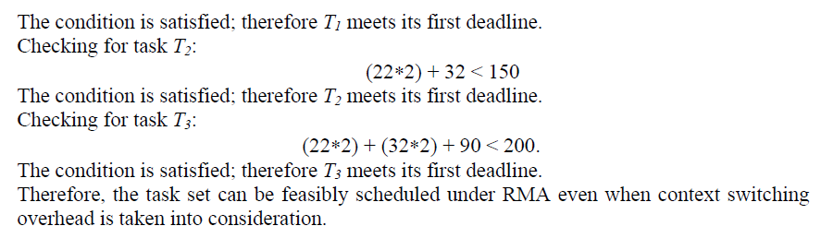

Slide 24
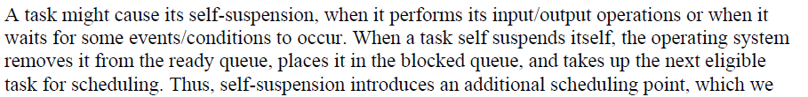
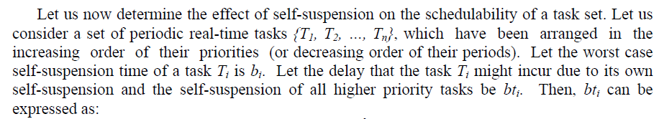


Self Suspension

Slide 25
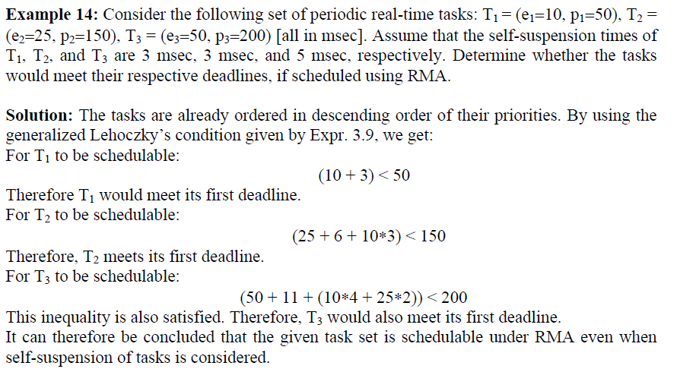

Slide 26
Self Suspension with Context Switching Overhead

Slide 27
